Slide 1
Sudoku
Presented To
Sir Taimur Sajjad
Presented By
Muhammad Jamshaid Iqbal
FA16-BCS-106
Pathani
FA16-BCS-104

Slide 2
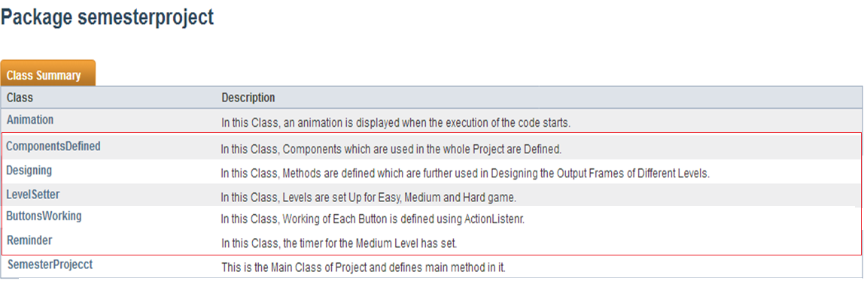
Class Hierarchy
Inherited Classes

Slide 3

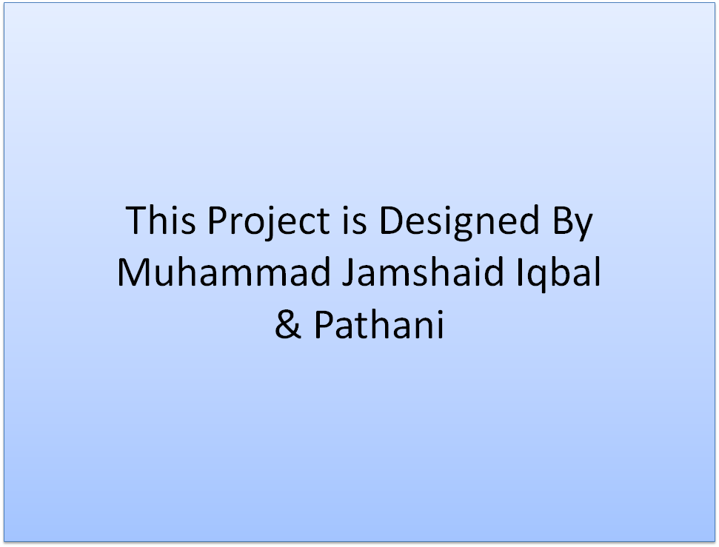
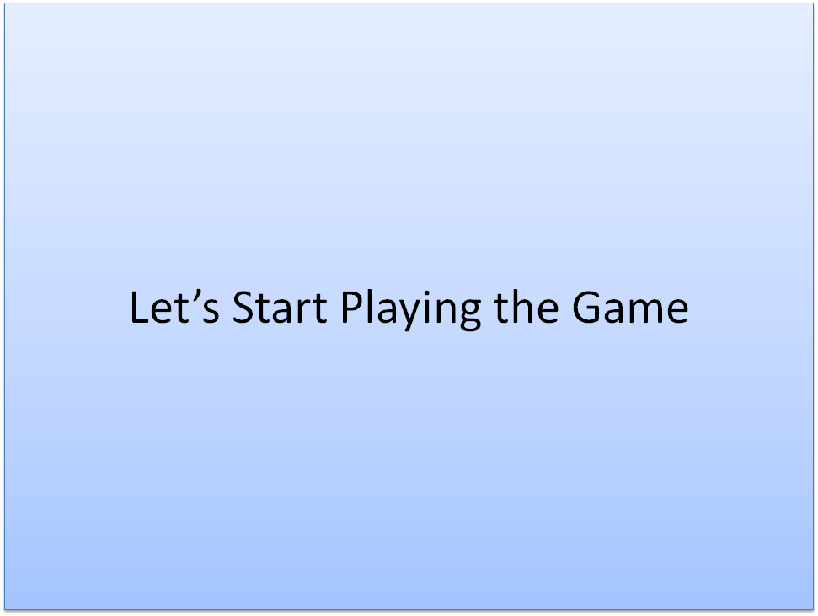
ANIMATION
These pictures Appears in a slide show with a delay of 1.5 seconds

Slide 4
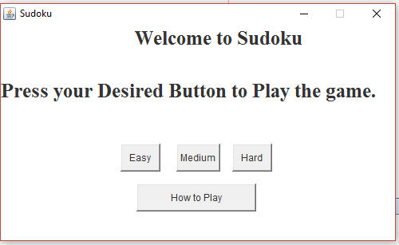
Welcome Screen

Slide 5
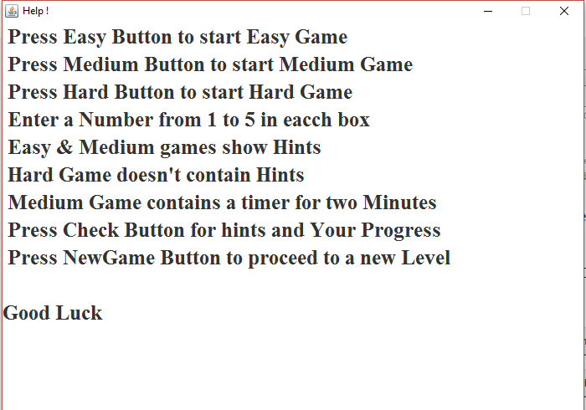
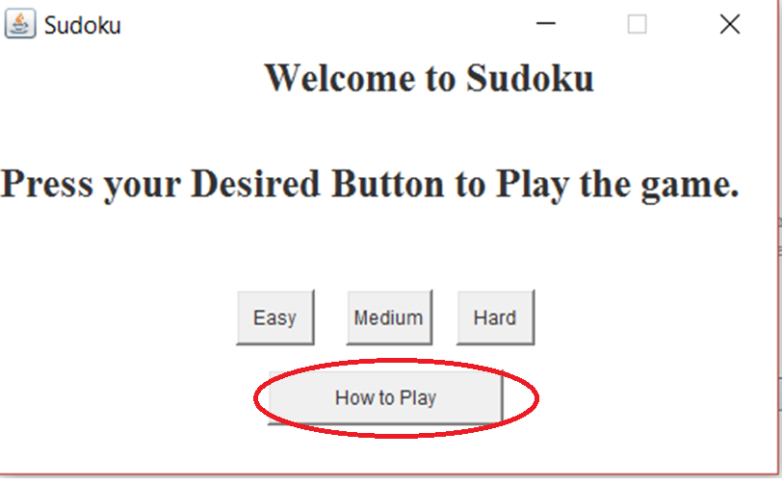
Help Content

Slide 6
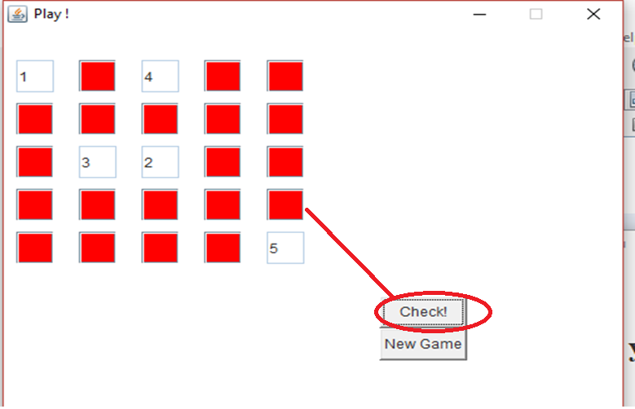
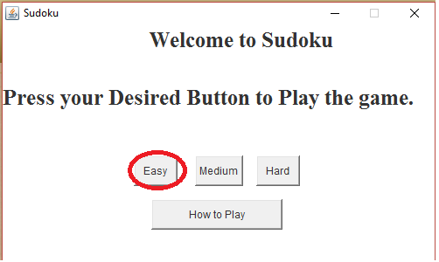
Easy Level and Check Button in Easy Level
When press check button
New Game Button proceed to a new level

Slide 7
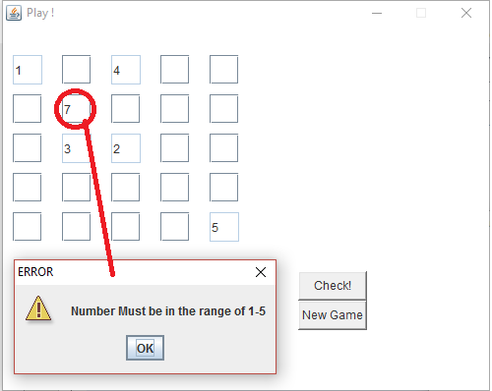
Error Number Input

Slide 8
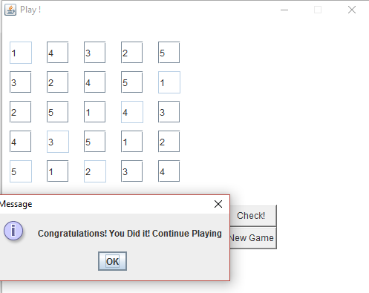
Level Completion Message
The level has Completed Successfully.
A message has been displayed to The user.

Slide 9
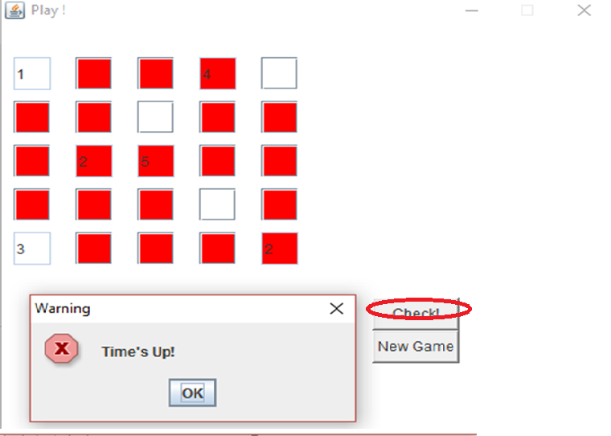
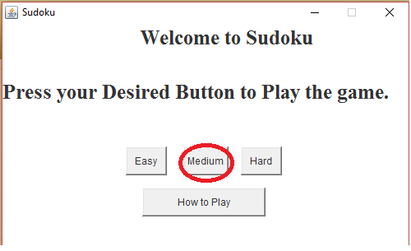
Medium level(check + Time Up)
When Press check on Medium Level
When Time ends before the level Completes
New Game Button proceed to a new level

Slide 10
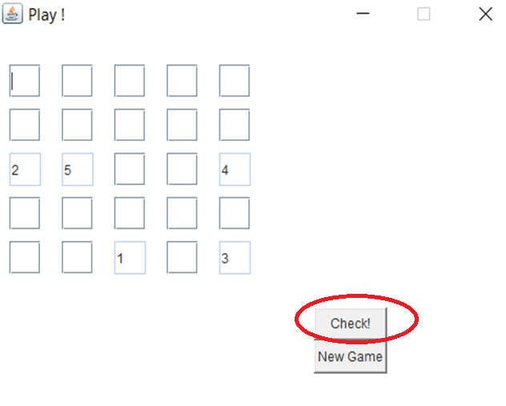
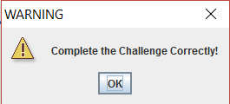
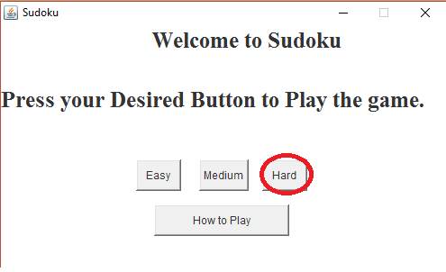
Hard Level(Check Button)
New Game Button proceed to a new level

Slide 11
